Slide 1
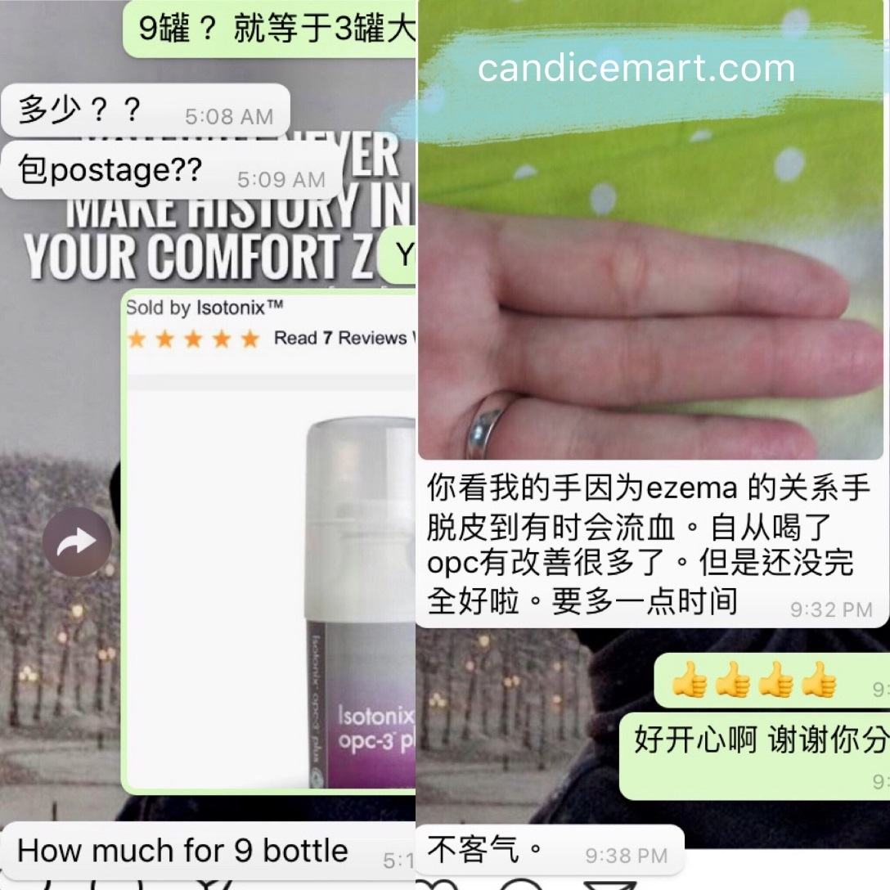
Be the Product of the Product Customers Referral and their Testimonials

Slide 2
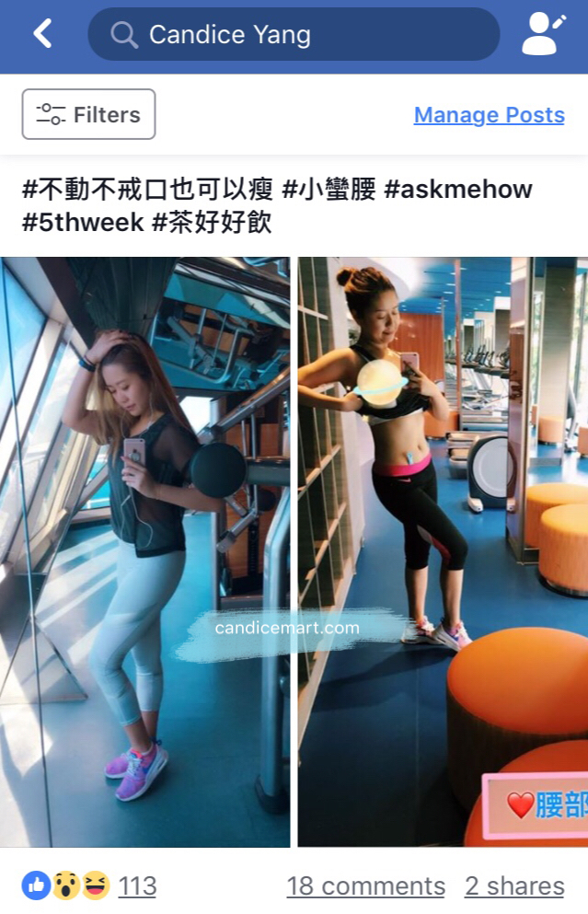
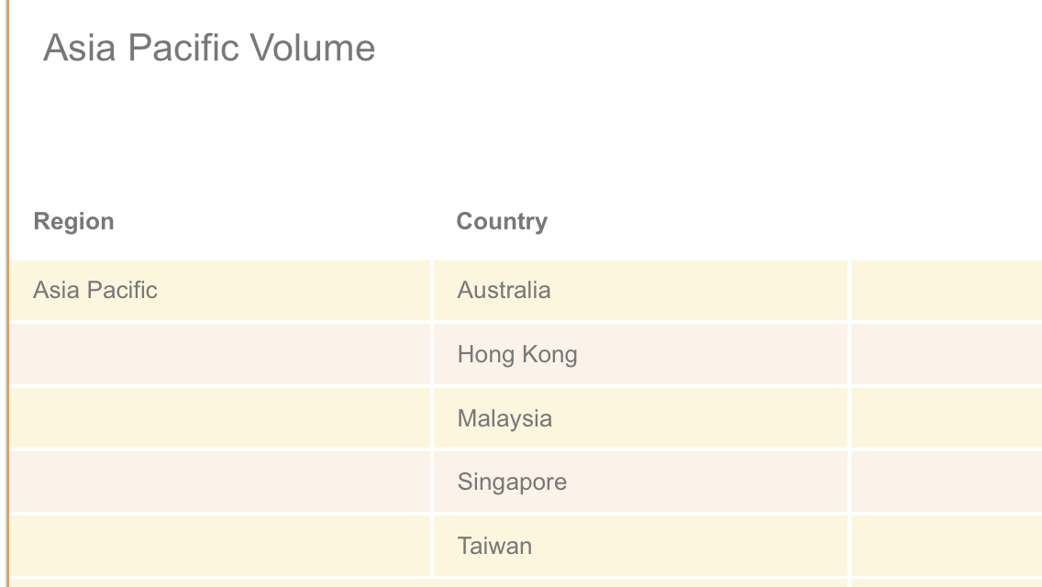
Leverage social media and sell globally

